Slide 1
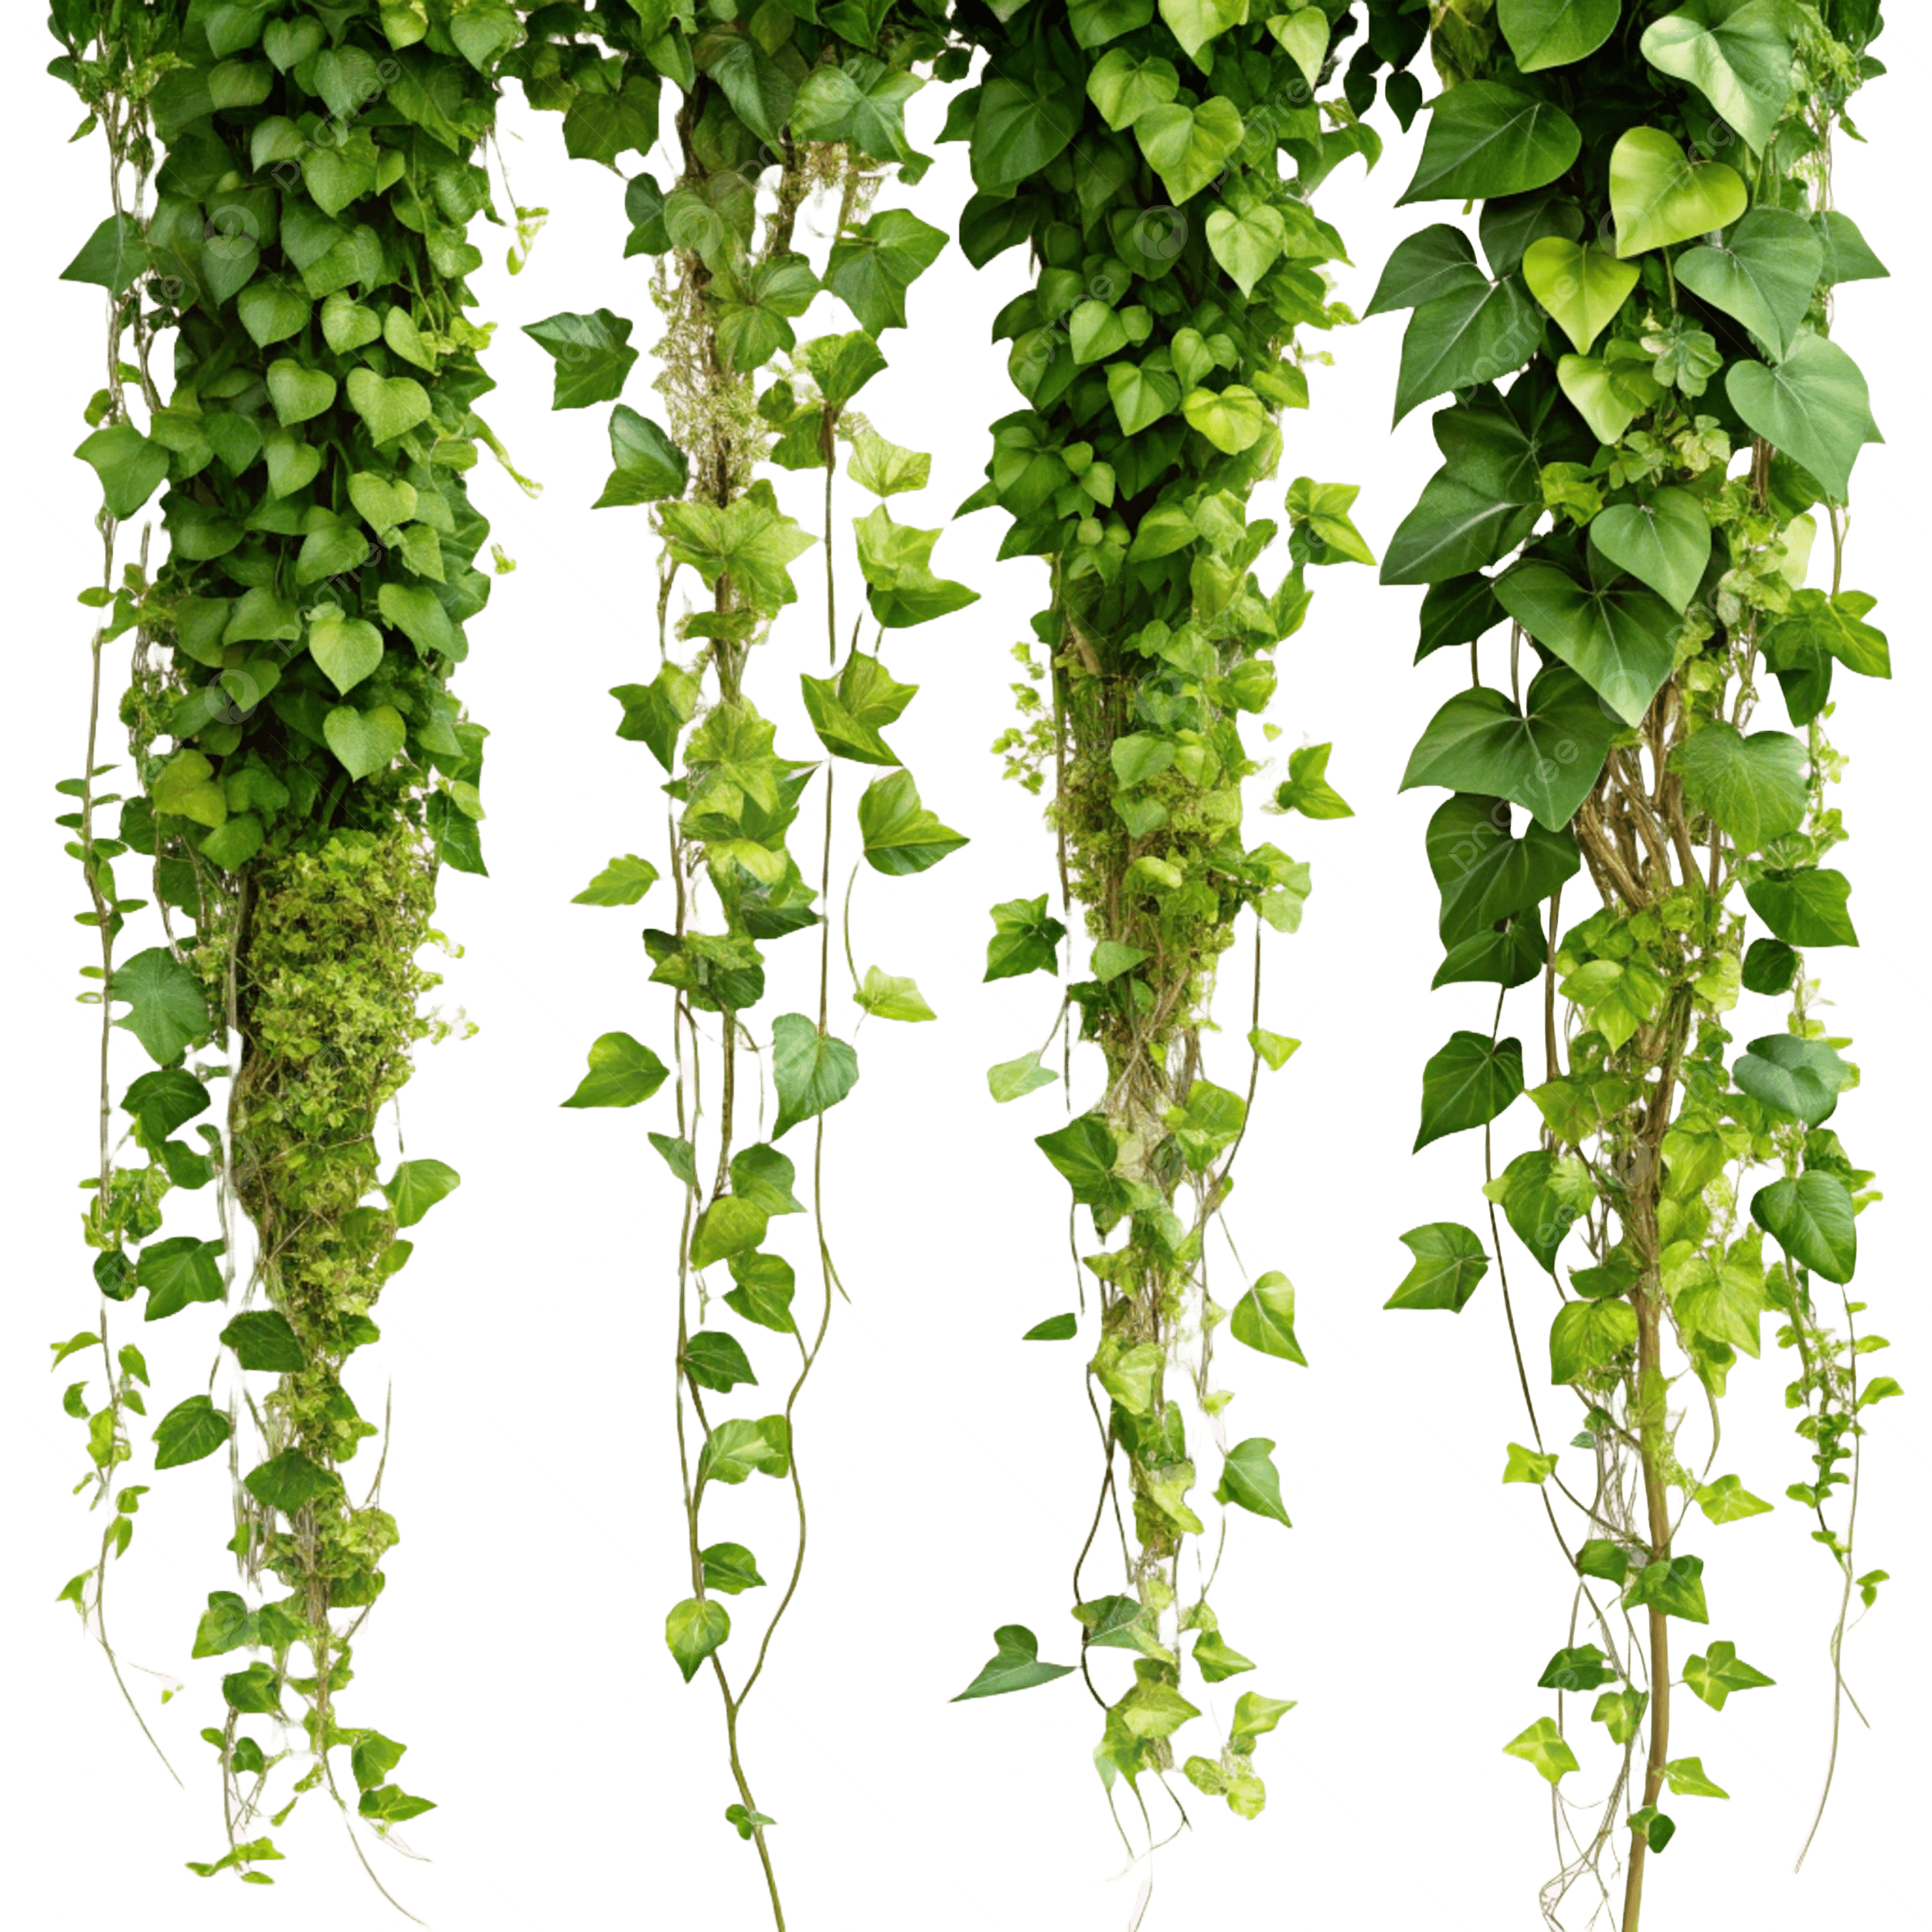

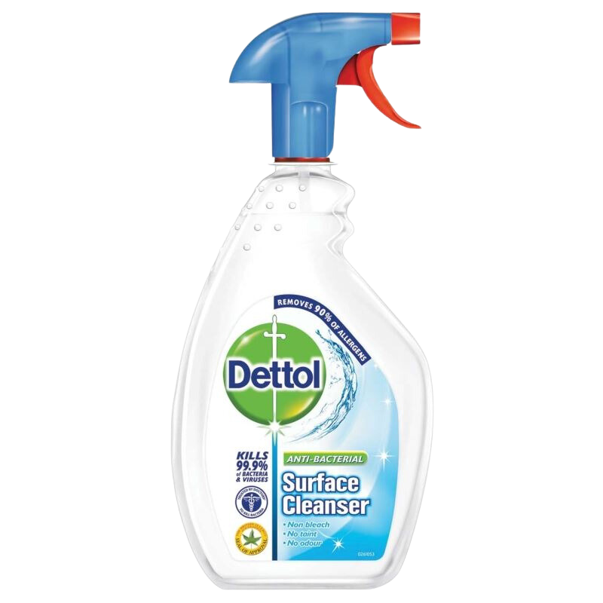

Level 1
Anti-bac spray damages you
Climb the vines
Water restores hydration metre

Slide 2
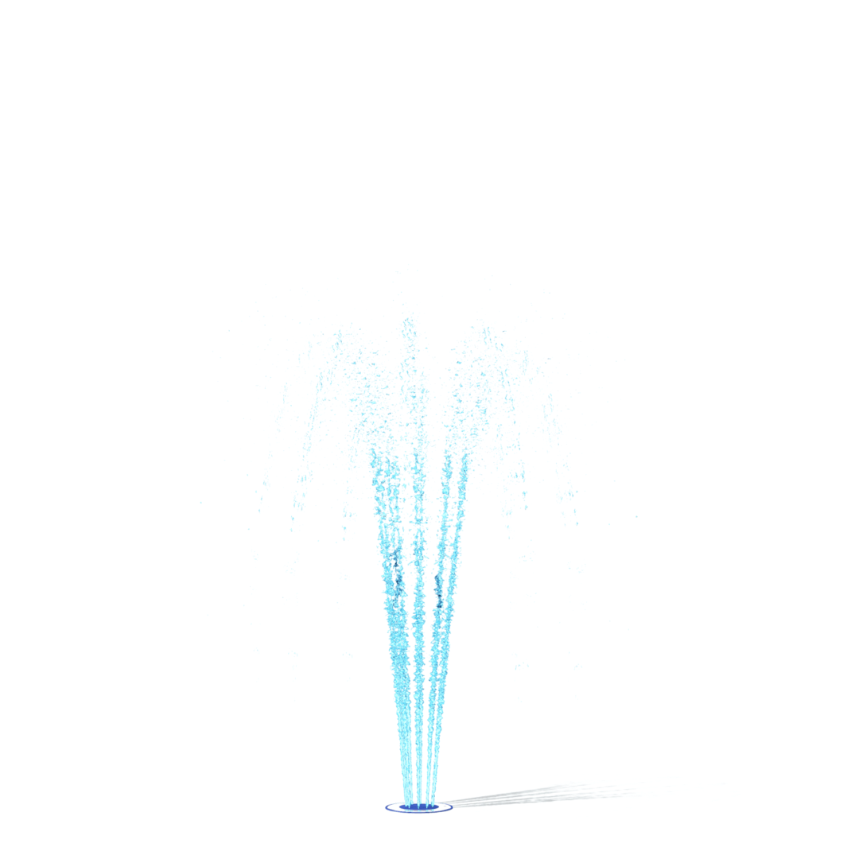

Level 2
Geyser sprays you upwards towards exit

Slide 3

Level 3

Slide 4
Level 4

